Slide 1



ADD COMPANY NAME
Information available in audio.

Slide 2


Purposes Of The Project
This project aims to explore the Walmart Sales data to understand top performing branches and products, sales trend of of different products, customer behaviour. The aims is to study how sales strategies can be improved and optimized
02

Slide 3

Analysis List
1. Product Analysis
Conduct analysis on the data to understand the different product lines, the products lines performing best and the product lines that need to be improved.
2 . Sales Analysis
This analysis aims to answer the question of the sales trends of product. The result of this can help use measure the effectiveness of each sales strategy the business applies and what modificatoins are needed to gain more sales.
3. Customer Analysis
This analysis aims to uncover the different customers segments, purchase trends and the profitability of each customer segment.
02

Slide 4






Approach Used
Data Wrangling
Elaborate on yoThis is the first step where inspection of data is done to make sure NULL values and missing values are detected and data replacement methods are used to replace, missing or NULL values.ur
second goal here.
Feature Engineering
This will help use generate some new columns from existing ones.
Exploratory Data Analysis (EDA)
Elaborate on your first goal here & last conclusion.

Slide 5


Business Questions To Answer
How many unique product lines does the data have? What is the most common payment method? What is the most selling product line? What is the total revenue by month? What month had the largest COGS? What product line had the largest revenue? What is the city with the largest revenue? What product line had the largest VAT? Fetch each product line and add a column to those product line showing "Good", "Bad". Good if its greater than average sales Which branch sold more products than average product sold? What is the most common product line by gender? What is the average rating of each product line? | 8

Slide 6
Business Questions To Answer
13.Number of sales made in each time of the day per weekday. 14.Which of the customer types brings the most revenue? 15.Which city has the largest tax percent/ VAT (Value Added Tax)? 16.Which customer type pays the most in VAT? 17.How many unique customer types does the data have? 18.How many unique payment methods does the data have? 19.What is the most common customer type? 20.Which customer type buys the most? 21.What is the gender of most of the customers? 22.What is the gender distribution per branch? 23.Which time of the day do customers give most ratings? 24.Which time of the day do customers give most ratings per branch? 25.Which day fo the week has the best avg ratings? | 8

Slide 7

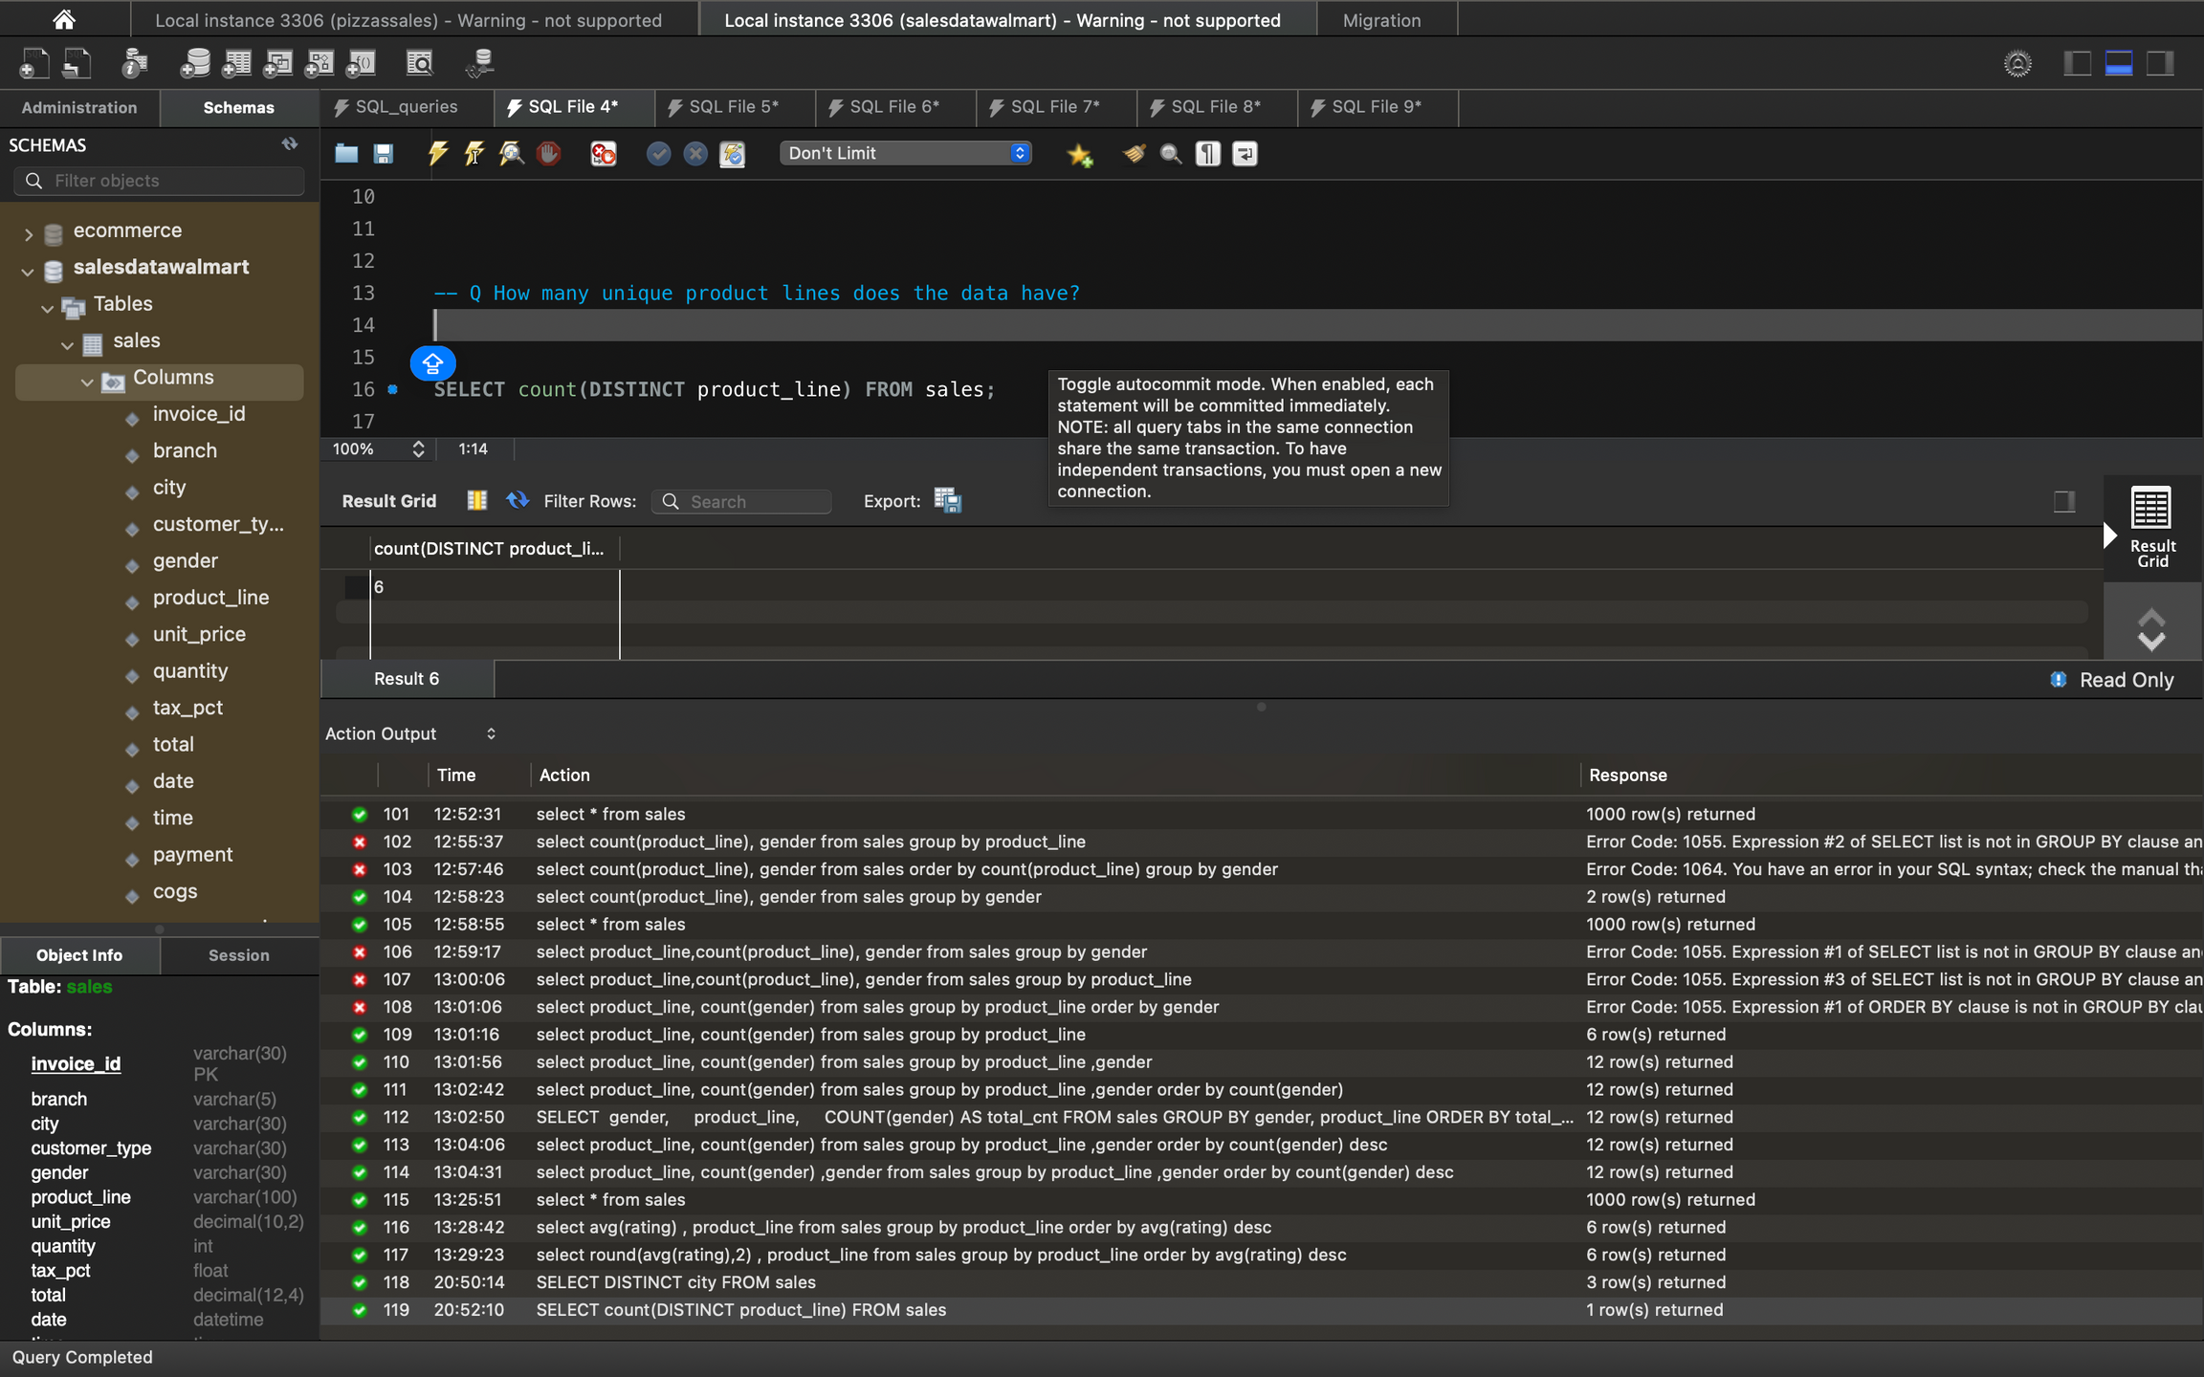
Q How many unique product lines does the data have?

Slide 8
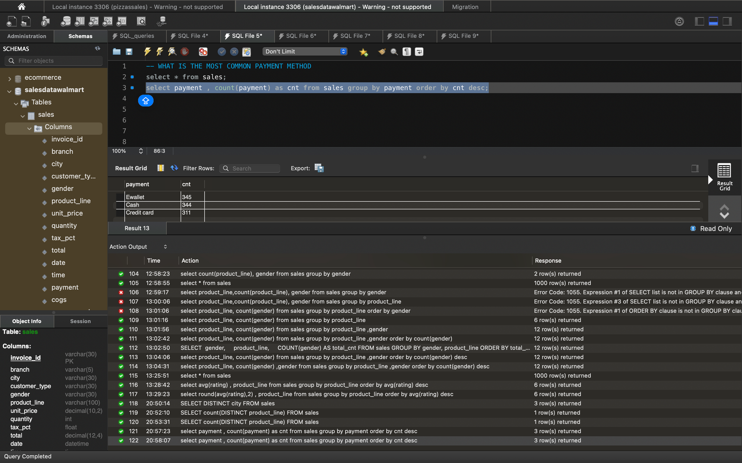
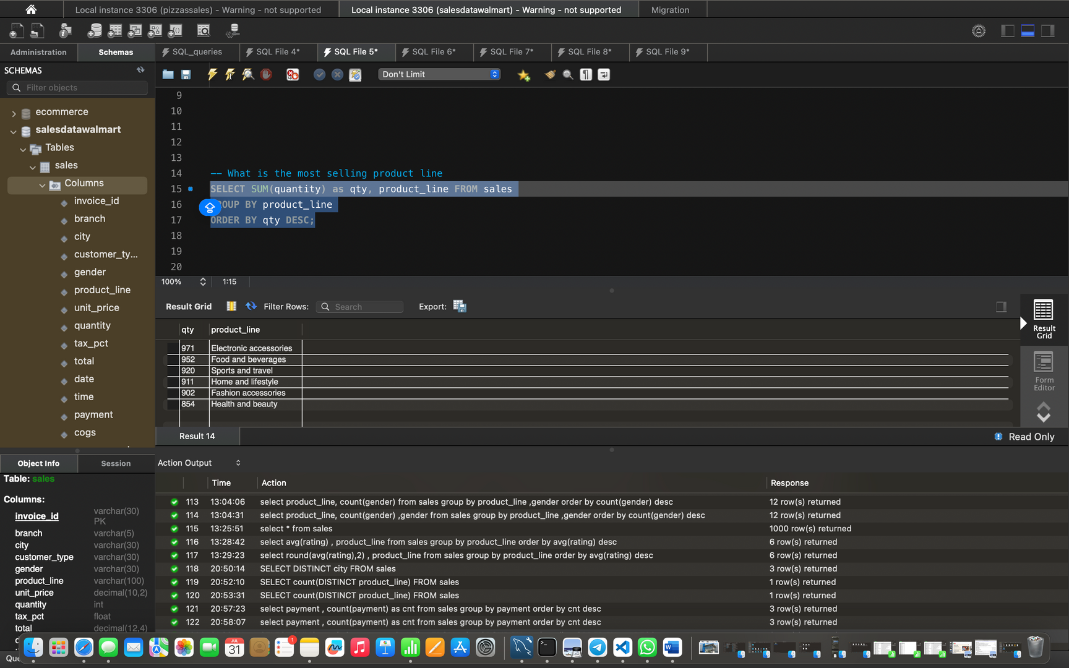
Q What is the most common payment method?
Q What is the most selling product line?

Slide 9
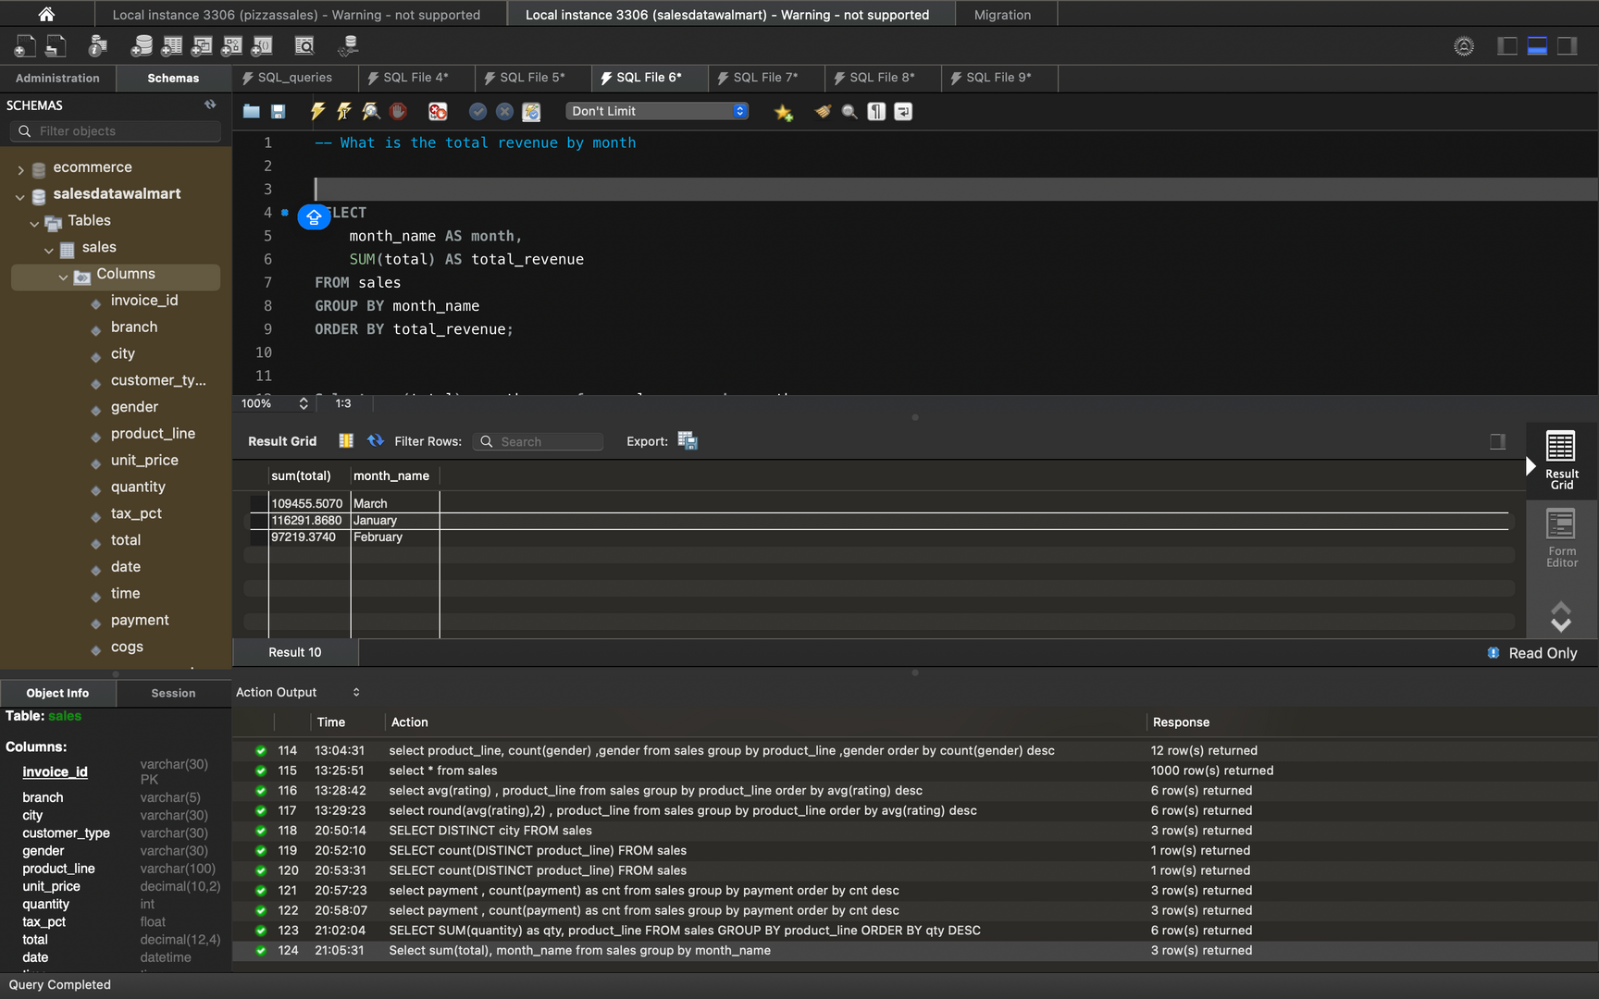
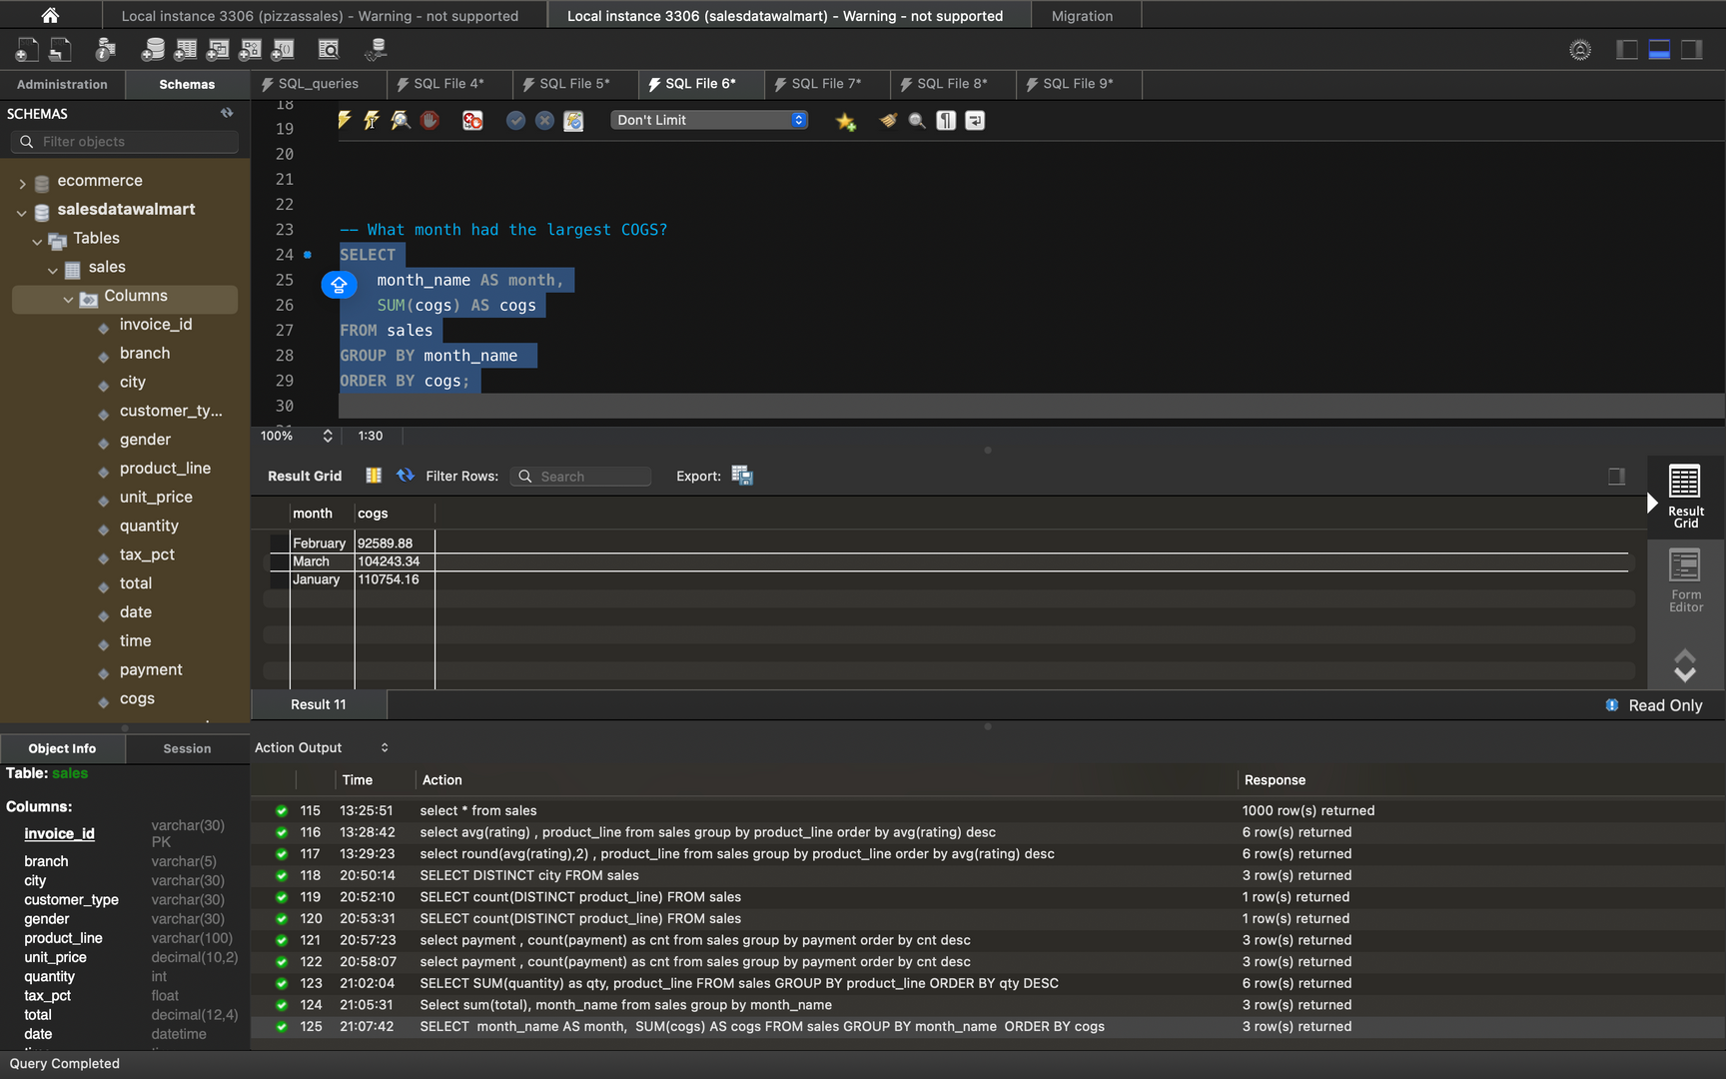
Q What is the total revenue by month?
Q What month had the largest COGS?

Slide 10
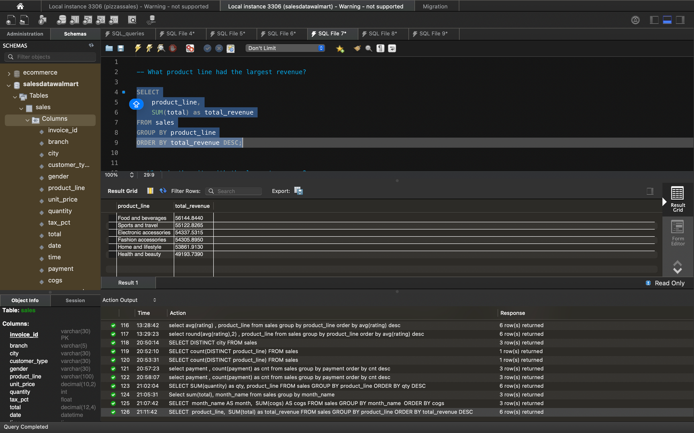
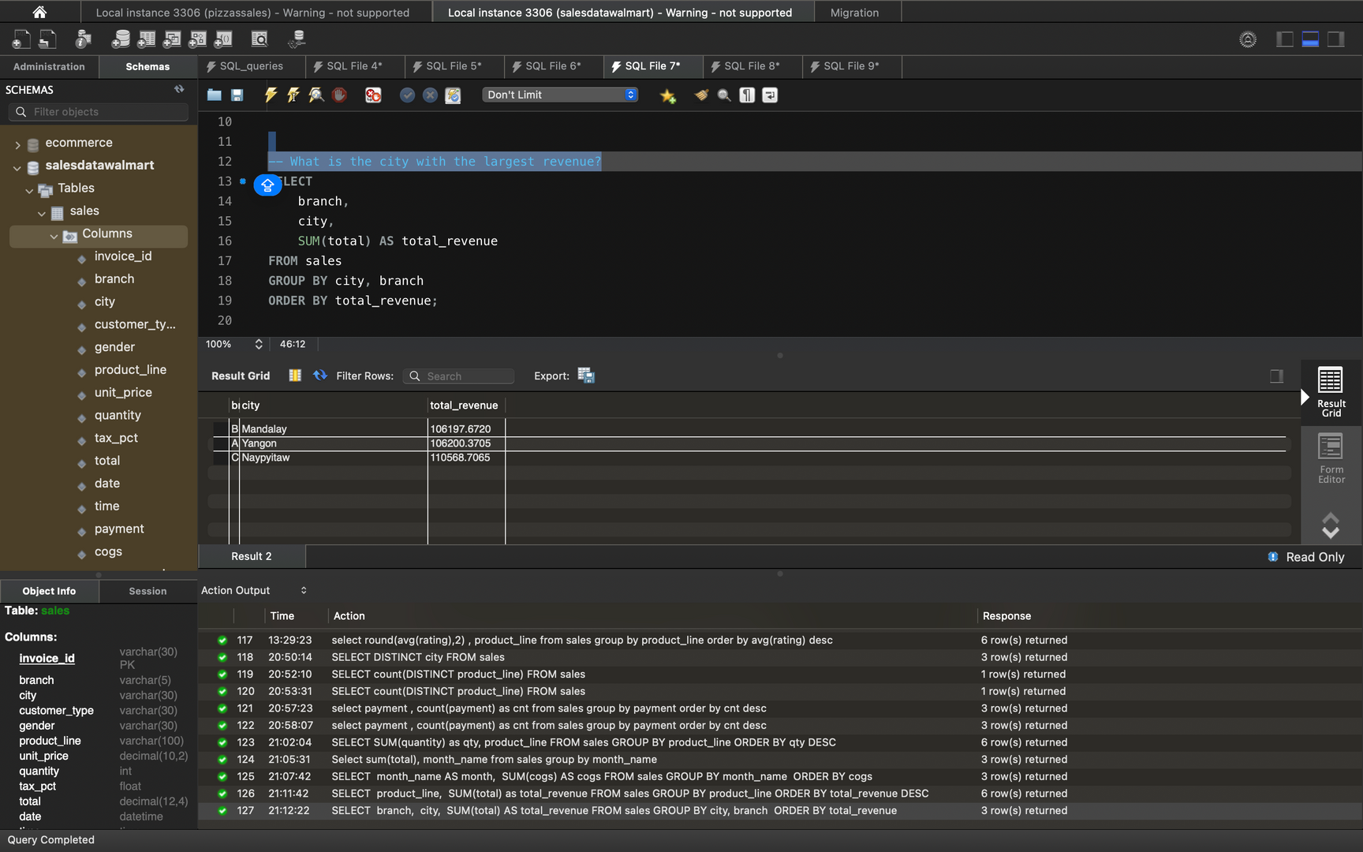
Q What is the city with the largest revenue?
Q What product line had the largest revenue?

Slide 11
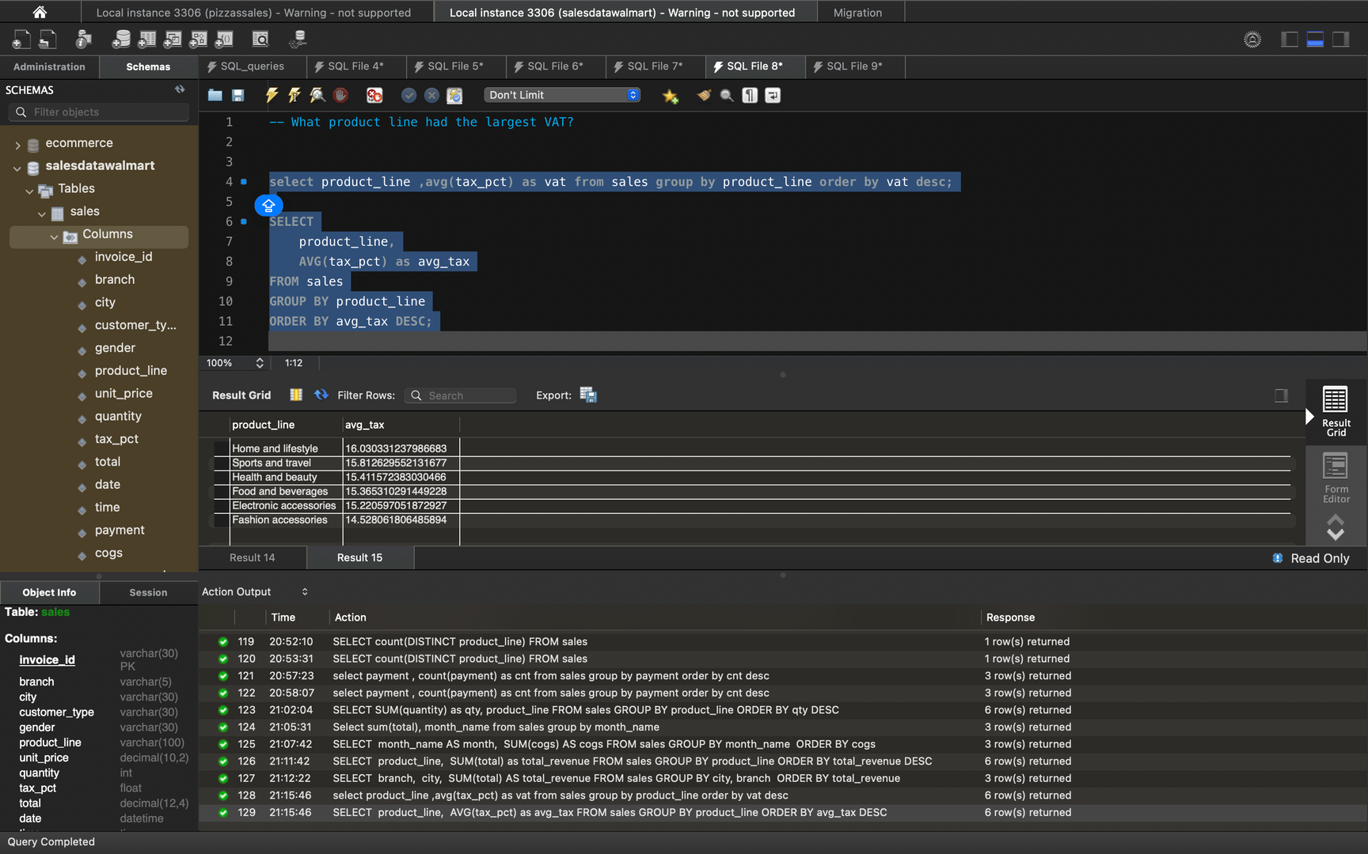
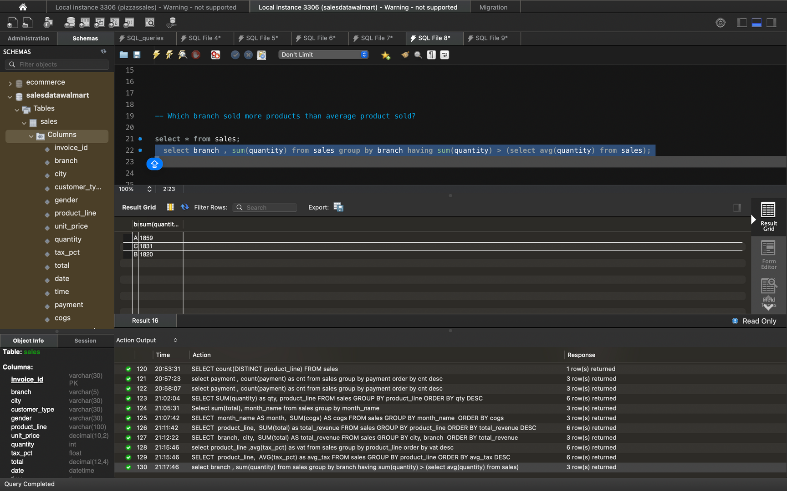
Q What product line had the largest VAT?
Q Which branch sold more products than average product sold?

Slide 12
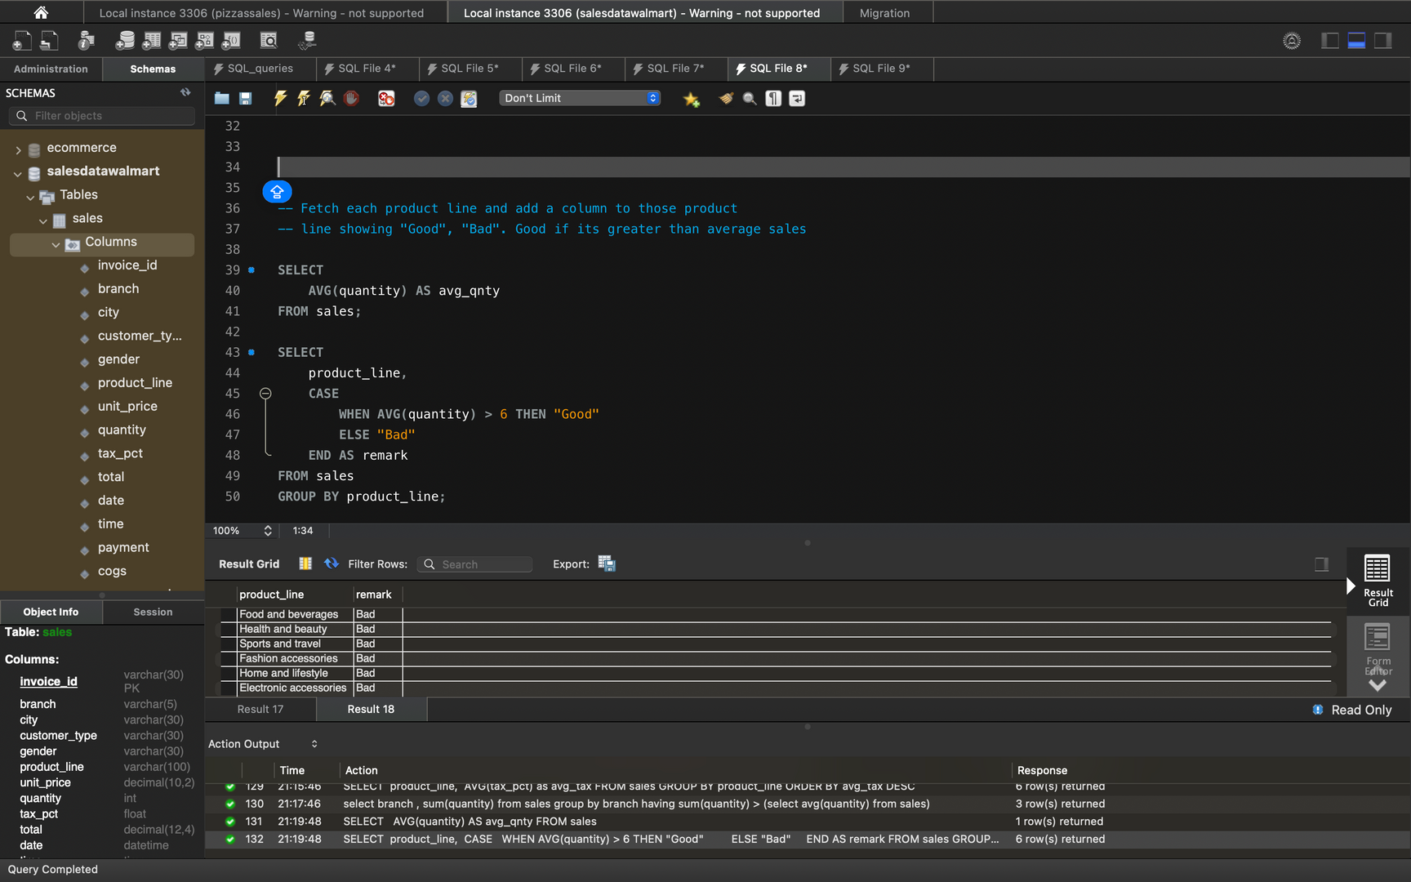
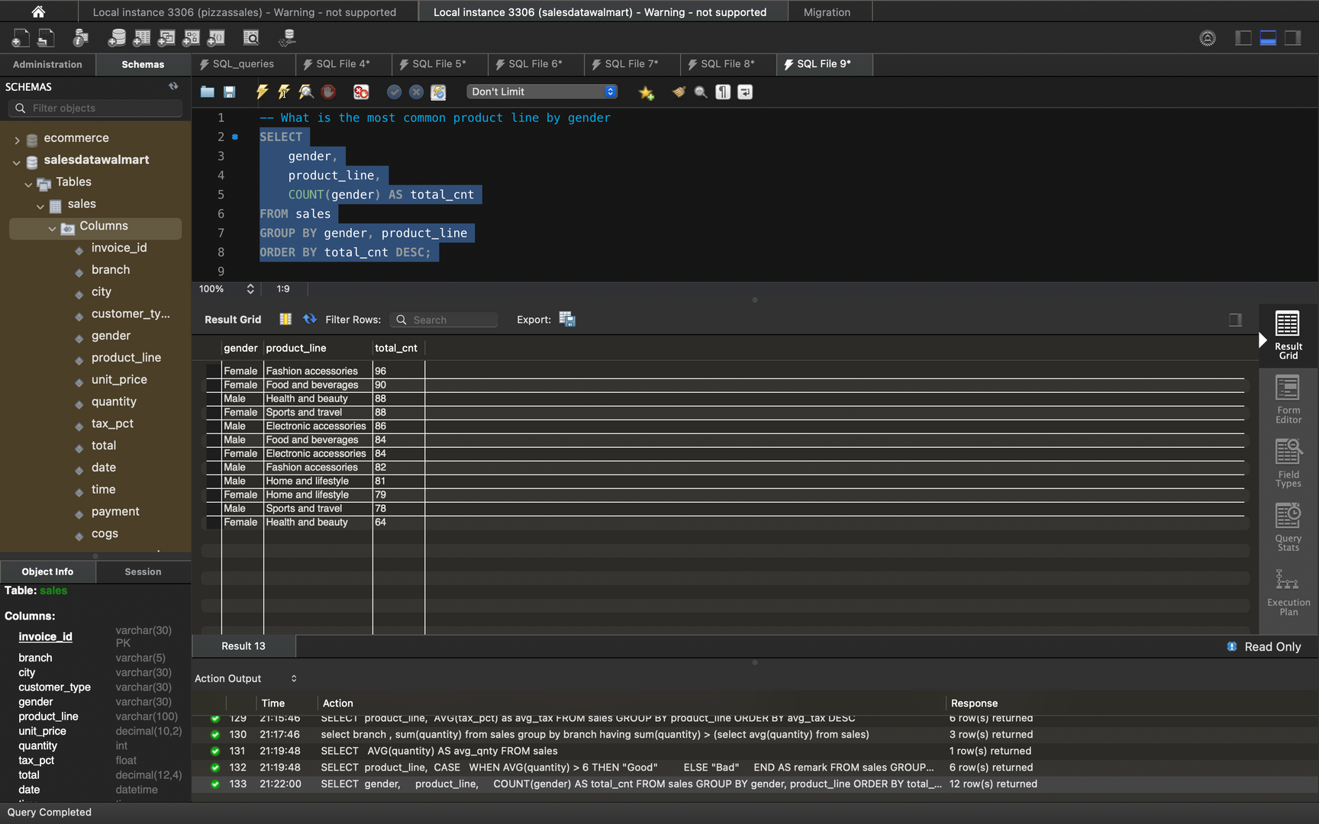
Q Fetch each product line and add a column to those product
Q line showing "Good", "Bad". Good if its greater than average sales
Q What is the most common product line by gender

Slide 13
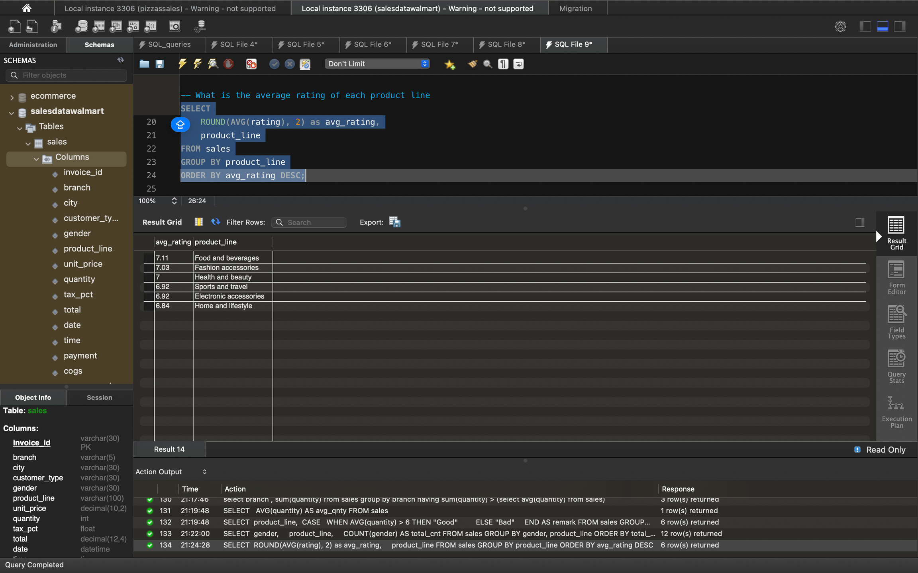
Q What is the average rating of each product line

